Slide 1
Coron Open Source --DIY Baidu Cloud ROM with Smali
https://github.com/baidurom/manifest

Slide 2
Features
Porting Baidu Cloud ROM on all Android 4.X devices
Patching modifications into OEM without conflict
Automatically upgrade ROM to the latest version
Rich utilities for self-customization

Slide 3
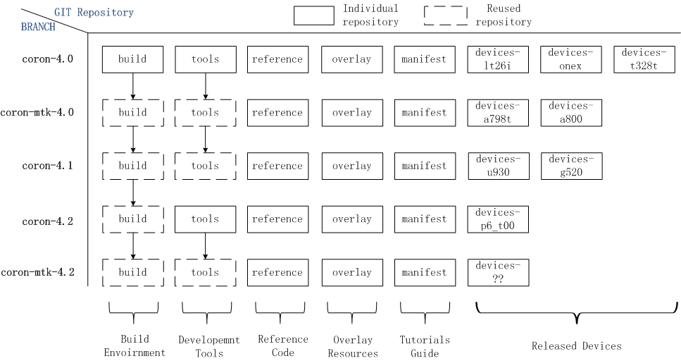
Structure

Slide 4
HowTo
Key Steps
1. Download the open source project
2. Initialize development environment
3. Patch smali code and bug fix
4. Upgrade ROM to the latest version

Slide 5
Thanks
https://github.com/baidurom
We hope some day you will join us.

